Slide 1










Slide 2








Array is a group of data that holds fixed number of value all of them are the same type
Syntax
Array_Type Array_Name[Length];
Example
This line creates an array of int of size 5.
array[0] array[1] array[2] array[3] array[4]
Array index starts
from 0 to 4
Notes:
The array index always starts from 0, it means that this array has elements from element 0 till element 4.
Array length must be constant value, can not be variable.

Slide 3








Array can be initialized at the time of definition. To initialize the arry use the following syntax:
Array_Type Array_Name[Length] = { values separated by comma };
Example
1
2
3
4
5
array[0]
array[1]
array[2]
array[3]
array[4]
int
Special Cases
1- Initializing the array with values less than its length, the remaining elements will be initialized with 0.
1
2
0
0
0
array[0]
array[1] array[2]
array[3] array[4]
int
2- Initializing the array with values more than its length, it would gives a compilation error.

Slide 4






All elements of the array can be accessed at the same statement only at initialization. After initialization the array can be accessed only element by element
Syntax
Array_Name[Element_Index]
Examples
Notes
Again, array index starts from 0.
You can use a variable to indicate for the element index, for ex: array[i] = 10; where i is variable equals to the desired index number.

Slide 5



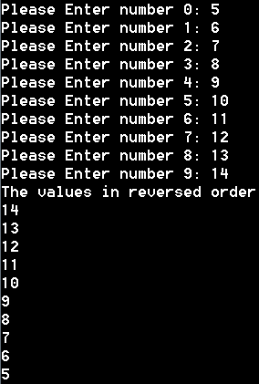




Expected Output
Write a C code that ask the user to enter 10 values and save them in an array using a for loop. Then print the values entered by the user in reverse order using another for loop.

Slide 6



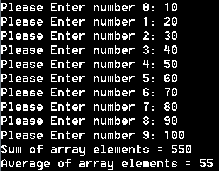



Expected Output
Write a C code that ask the user to enter 10 values and save them in an array using a for loop. Then print the summation and the average of the values entered.

Slide 7



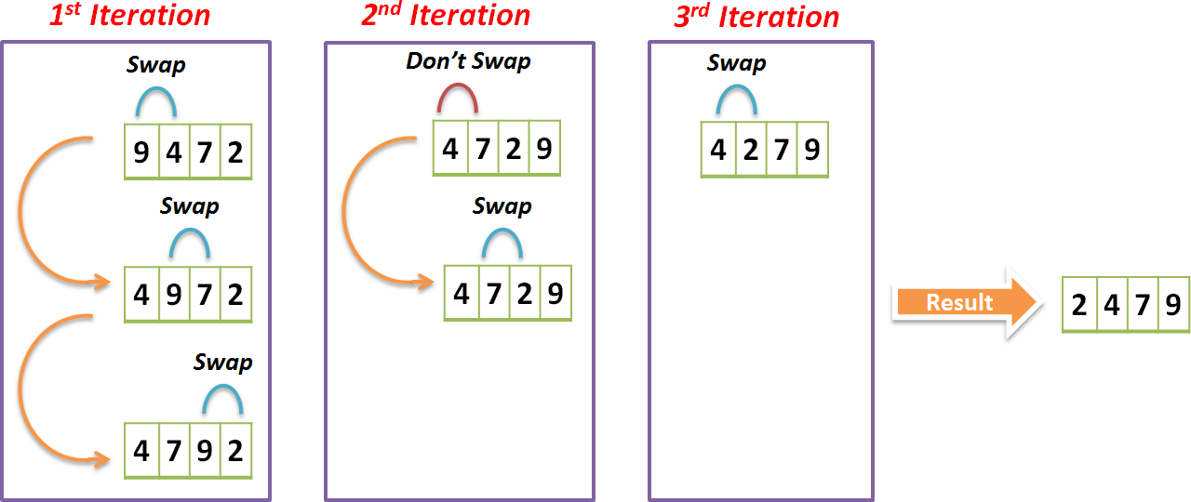
Sorting is a mean of managing data, There are many algorithms each algorithm has particular strengths and weaknesses. One of the simplest sorting algorithms is the Bubble Sorting.
Bubble Sorting Concept
Notes:
Number of iterations = Size of array – 1

Slide 8

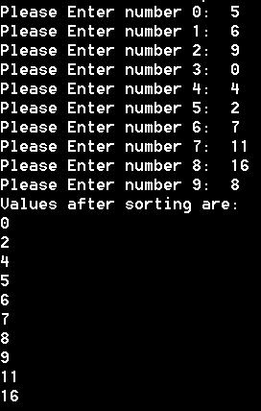

Expected Output
Write a C code that ask the user to enter 10 values and save them in an array using a for loop. The code then apply the bubble sorting algorithm and then print the values after sorting.

Slide 9



a- Linear Search (Sequential Searching Algorithm)
This is the simplest way to
search inside an array. The
the
idea is to start from
beginning of the array till the end and compare each element of the array with the element to search until you find it.

Slide 10




Write a C code that ask the user to enter 10 values and save them in an array using a for loop. Then ask the user to enter a value to search about, if the value existing in the 10 values, the program will print “Value Exists x times” where x defines how many times the value exists. If the value is not exist, the program will print “Value Not Exist”. Use Linear Searching Algorithm.

Slide 11
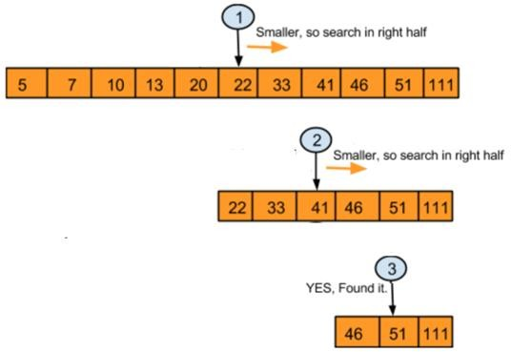
This type of searching depends on sorting the array first. If the array is already sorted, it would save a lot of time in the searching process
a- Binary Search (Sort then Search)
Example
In this arrays, number 51
search for

Slide 12



Write a C code that ask the user to enter 10 values and save them in an array using a for loop. Then ask the user to enter a value to search about, if the value existing in the 10 values, the program will print “Value Found”. If the value is not exist, the program will print “Value Not Exist”. Use Binary Searching Algorithm.

Slide 13
Any questions
… ?

Slide 14



Write a C code that ask the user to enter 10 values and save them in an array
using a for loop. Then print the minimum and the maximum of the values.

Slide 15


Write C code that manage a small school. The school has 3 classes each class contains 10 students. Define three arrays for the three classes each one with a length of 10. Save a random numbers in all array elements to indicate the students grade. The program will calculate and display the following statistics:
1- Number of passed students 2- Number of Failed students 3- Highest grade
Lowest grade
Average grade
Knowing that the total grade is from 100 and the minimum passing grade is 50.

Slide 16
Thank you

